Slide 1


\
Request for Proposals # 3
TCU Building Bridges Grant Program
A Science, Technology, Engineering & Math (STEM) grant-funding opportunity developed in partnership with the American Indian Higher Education Consortium (AIHEC) and the National Aeronautics and Space Administration (NASA)
Information Session & Call for proposals
Funded by National Aeronautics and Space Administration (NASA)
Award Number 80NSSC24M0025

Slide 2



Timeline
& Overview
To guide the application process, four webinars will be held to provide guidance, highlight best practices, offer resources, outline expectations, and address questions.
\
1 – Information Session + Q & A (May 29)
2 – Workshop: Community of Practice (June 5)
3 – Workshop: Building A Competitive Proposal (June 11)
4 – Workshop: Budget Development (June 25)
5 – Office Hours (July 9)
*Webinars will also be recorded and uploaded to AIHEC.org TCU Building Bridges webpage for review

Slide 3

Today’s Agenda
Welcome
  Team Introductions
RFP Overview
  Programmatic Goals & STEM Engagement Goals
  Priority Areas for Support
  Shelly Knight:
  FAA Part 107 commercial pilot license for small UAS and an
  FCC Part 97 technician license for amateur radio waves.
Resources
Timothy Raymond: Faculty Dept. Chair / FAST Lab Director at KBOCC
Pre- to Post-Award Experience
Closing & Next Steps
Notes:
Enhancing Experiential Based Learning within Engineering at Tribal Community Colleges in September 2024 – 1-year award

Slide 4
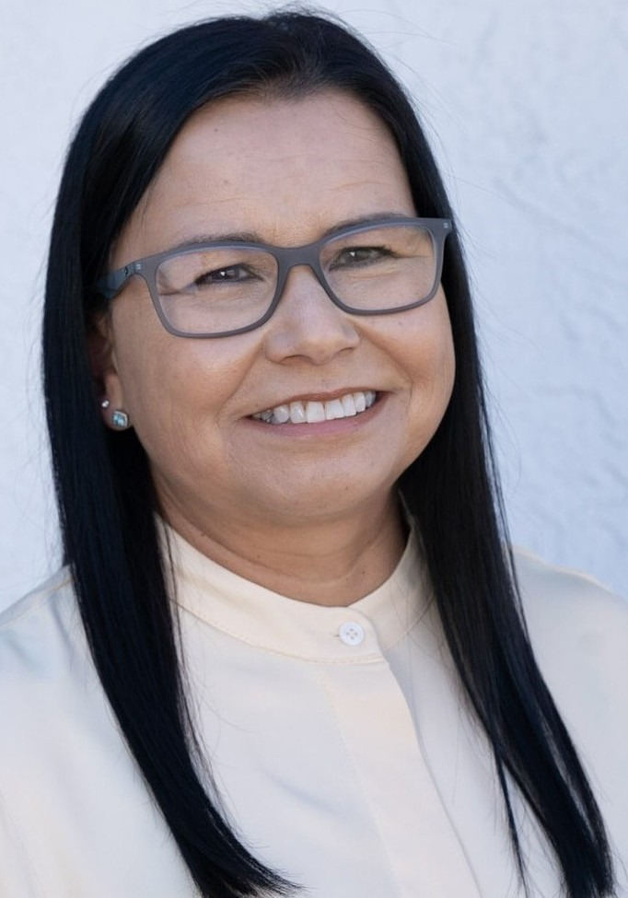


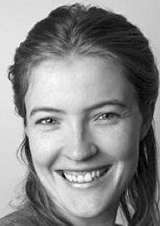
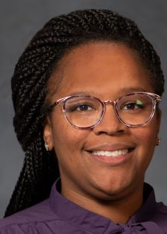
TCU Building Bridges Team

Slide 5
RFP Overview
RFP RELEASE DATE: May 19, 2025
PROPOSAL DUE DATE: 11:59 PM Eastern Time (ET) July 14, 2025
FUNDING AMOUNT: Multiple awards of up to $68,600 are available
ELIGIBILITY: Funds are available to faculty led teams from all accredited Tribal Colleges & Universities
ESTIMATED CONTRACT PERIOD: October 1, 2025 – September 30, 2026, or up to 2 years (24 months) from date of award, depending on the scope of the project. Projects designed for shorter periods of time will receive equal consideration.

Slide 6
RFP Overview – Purpose
The Building Bridges Grant program is designed to provide funds to improve infrastructure, update academic program content, student research opportunities, faculty professional development, bridging activities, and other initiatives to support TCU efforts to develop and enhance their STEM programs.
Through the provision of funding, it is NASA & AIHEC’s hope that the program will enhance the ability of TCUs to:
          Provide high quality STEM education programs
      Participate in collaborative STEM research initiatives
      Ensure the inclusion of American Indians and Alaskan Natives in a well-prepared NASA STEM workforce.

Slide 7
RFP Overview - Programmatic Goals
The NASA AIHEC Bridges Program seeks STEM program enrichment projects such as course and curriculum development, research activities, and student engagement with the overall goal of broadening TCU students’ participation in STEM. NASA AIHEC Bridges Program funded projects are expected to address at least two of the three program goals:
Strengthen the capacity of the Tribal College to deliver STEM courses, degrees and curriculum
Increase the number of Tribal College students engaging in STEM research and education activities. (Examples: internships, externships, Experiential Learning Opportunities (ELOs), Research Experiences for Undergraduates (REUs))
Increase enrollment of Tribal College students in STEM degree programs and pursuing STEM career pathways
.
Notes:
We are trying our best to be expansive, not restrictive. Hopefully the message you take away from this is that there are a lot of possibilities, and if you are unsure, just ask!

Slide 8
RFP Overview - STEM & Engagement Goals
In addition to addressing the programmatic goals, each proposal must demonstrate how they will align to at least one of the following NASA Office of STEM Engagement Goals below:
1. Strategic Goal 1.0: Create unique opportunities for a diverse set of students to contribute to NASA’s work in exploration and discovery.
2. Strategic Goal 2.0: Build a diverse future STEM workforce by engaging students in authentic learning experiences with NASA’s people, content and facilities.
3. Strategic Goal 3.0: Attract diverse groups of students to STEM through learning opportunities that spark interest and provide connections to NASA’s mission and work.
Notes:
We are trying our best to be expansive, not restrictive. Hopefully the message you take away from this is that there are a lot of possibilities, and if you are unsure, just ask!

Slide 9

STEM Engagement Strategy
NASA Strategic Goal 4
Enhance capabilities and operations to catalyze current and future mission success.
NASA investments in STEM engagement are focused on building a future STEM workforce, through program elements designed to bolster capacity and to attract, engage and enable students to move toward STEM careers through NASA-unique opportunities.
Attracting students to STEM through unique learning opportunities that spark interest and provide connections
to NASA’s mission and work.
Engaging students in authentic learning experiences with NASA’s people, content, and facilities.
Enabling students to contribute to NASA’s work in exploration and discovery through challenges and work experiences.
10

Slide 10
RFP Overview – Priority Areas
Priority areas for support will include, but are not necessarily limited to:
    Research opportunities for undergraduate students;
    STEM program instrumentation/equipment acquisitions;
    Course and curriculum enhancements (new courses, delivery support technologies)
    Professional development for TCU faculty, including conferences and workshops;
    In-person meetings with NASA researchers and engineers available for collaborative projects;
    Other activities that increase TCU students’ interest and engagement in STEM fields, at the elementary, high school and undergraduate level, including participation in STEM enrichment activities, conferences, workshops and competitions.
Notes:
We are trying our best to be expansive, not restrictive. Hopefully your take away from this is that there are a lot of possibilities, and if you are unsure, just ask!

Slide 11

Wendy Huntoon, CI Team Director | ghuntoon@aihec.org
Jeff Letourneau, Sr. Technical Expert | jletourneau@aihec.org
Alex Grandon, CI Coordinator | agrandon@aihec.org
Shelly Knight, CI Facilitator | sknight@aihec.org
Cyberinfrastructure Team
Shelly Knight
Notes:
Purpose: Campus’ cyberinfrastructure is foundational to student success and academic achievement.
Challenges: Access to CI resources (funding, training, and staffing) and awareness of science drivers
TCU Priorities from CI Study:
Native Languages and Data Storage
Climate and Data Science
Geographic Information Systems and technology (GIS/GIT)
Indigenous Data Sovereignty and Network
Communities of Practice: ITD/CIO Community of Practice
Working Groups: GIT and Drones | Artificial Intelligence | Esports

Slide 12
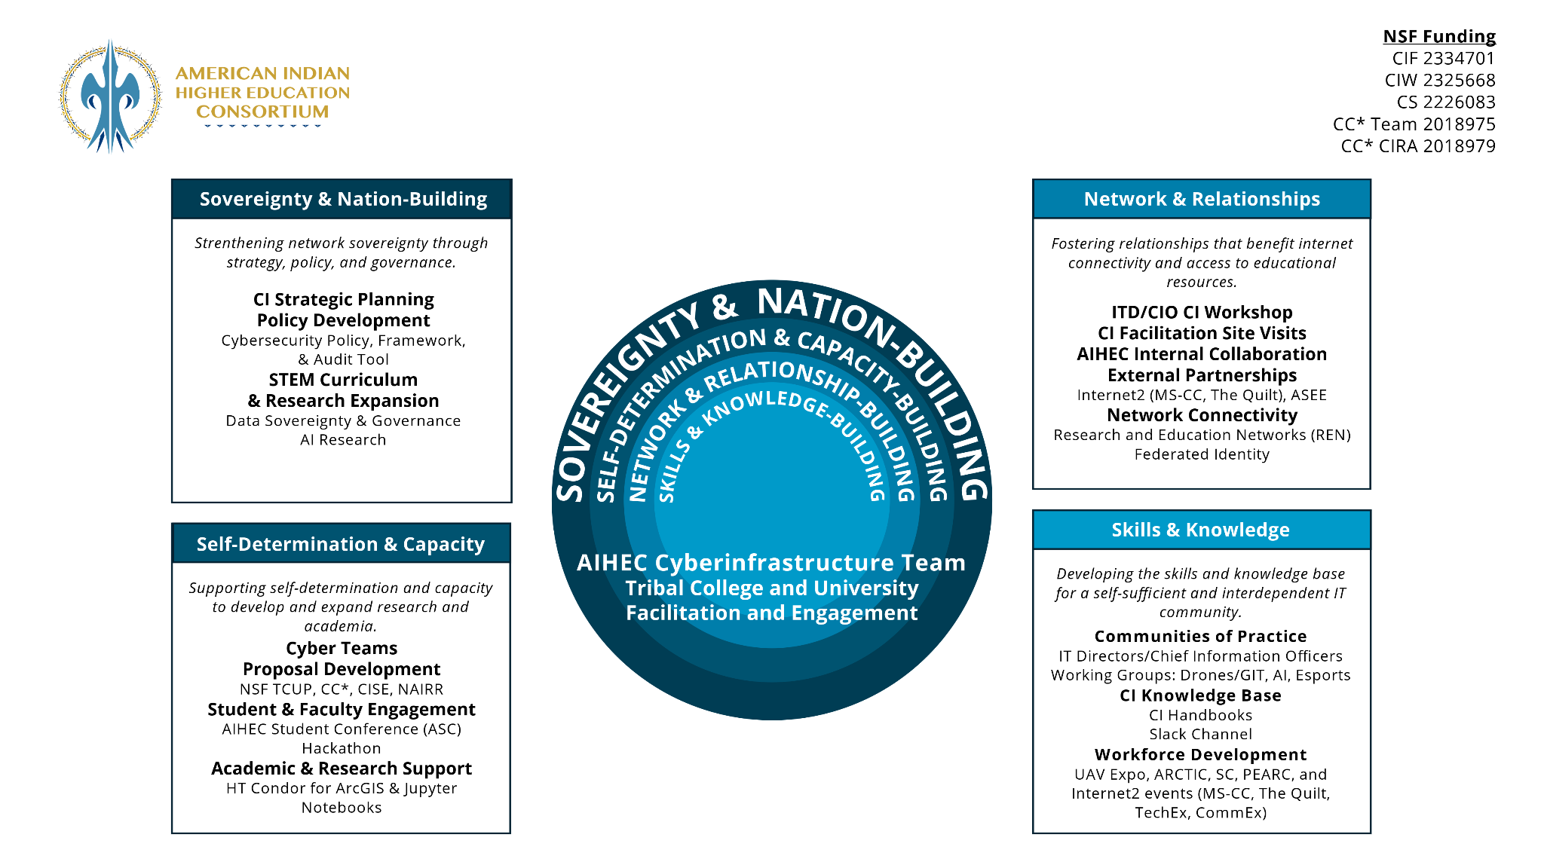

Slide 13
AIHEC’s Cyberinfrastructure Initiatives
TCU Working Groups - AI, Drone/GIT, and Esports
Annual TCU CI Workshop - STEM faculty and IT staff
HTC Pilot - Virtual Machines (VMs) for enabling High-throughput Computing (HTC)
Storage and Data Management - Language repositories and archives
Federated Identity Pilot - Access to library resources and large datasets
External Partnerships - Internet2, Project QuiPu, AISES, ASEE, FAA, etc.
Workforce Development - Hackathon, Dreamhack, UAV Expo, etc.
Notes:
AI Working Group
Sharing AI best practices and data sovereignty solutions
Developing AI infographics for TCU leaders, educators, and students
Creating AI digital twins for STEM applications
Language repositories and archives
Exploring Mukurtu and similar tools
Improving internet connectivity and data storage

Slide 14
AIHEC’s Cyberinfrastructure Team
Nia:wen!
Questions?

Slide 15
Resources
WEBPAGE LINK
WEBPAGE NAVIGATION:
Links to Webinar Registrations and Supporting Media
                Post-webinar Links
                Documents and Templates
                Submission Buttons
                Pre-Application Submission – Note: June 13th deadline (buildingbridges@aihec.org)
                Survey

Slide 16

Tim Raymond – KBOCC Faculty
Human Studies Faculty Department Chair and FAST Lab Director
Awarded 1-year project: Enhancing Experiential Based Learning within Engineering at Tribal Community Colleges
Share pre- and post-award experience with the TCU Building Bridges program

Slide 17
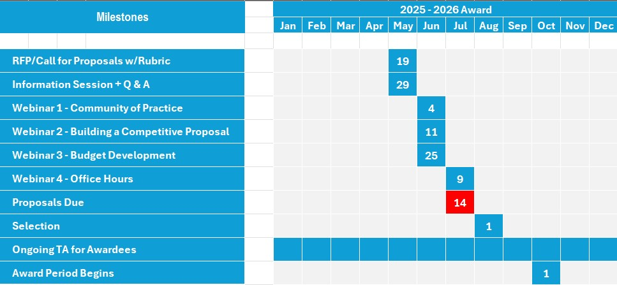
\
Timeline
& Overview
Notes:
Will be part of intro slides in future sessions

Slide 18












TCU Building Bridges Awarded Projects
Round 1 and 2 of the Building Bridges award cycle saw 13 awarded projects

Slide 19
\
We will come back together next Wednesday, June 5th for a Community of Practice Workshop
Review the RFP and Proposal Process
Please Register on AIHEC’s
TCU Building Bridges Webpage
(Dropping Link in Chat)
Notes:
https://app.smartsheet.com/b/form/d7b1cc948a424d849d977da80b65758e

